Slide 1
BHE Authorization to Solicit Public Comment: Financial Review and Risk Monitoring Regulations (610 CMR 13)
Board of Higher Education Meeting – June 18, 2019

Slide 2
THESIS Timeline Overview
BHE Authorization to Solicit Public Comment: 610 CMR 13
April 2018: Mount Ida College announces abrupt closure
June 2018: BHE forms THESIS working group
Summer and Fall 2018: THESIS group meets, conducts research and analysis, develops recommendations
January 22, 2019: BHE accepts THESIS Working Group report and charges Commissioner to develop implementation recommendations (BHE 19-04)
January–June 2019: Informal stakeholder vetting; regulation drafting
June 18, 2019: BHE votes to put draft regulations out for formal public comment (BHE 19-06)
June–August 2019: Public Comment period; DHE staff revise regulations as needed; finalize policies
August 19, 2019 BHE Meeting: BHE Vote on final regulations
Fall 2019: Implementation
TODAY

Slide 3
610 CMR 13: Scope and Purpose
BHE Authorization to Solicit Public Comment: 610 CMR 13
Scope: All MA-based, private higher education institutions (IHEs) that are:
authorized by BHE to grant degrees in MA; and/or
authorized to participate in state’s financial aid program
Purpose of Regulations: Establish standard and processes to permit BHE (acting through Commissioner/ Department) to:
identify, through annual screening process, IHEs experiencing significant financial distress, placing them at risk of imminent closure;
monitor identified IHEs while they either improve their financial condition or transition to closure; and
allow for contingency closure planning and timely public notification in the event of imminent closure.

Slide 4
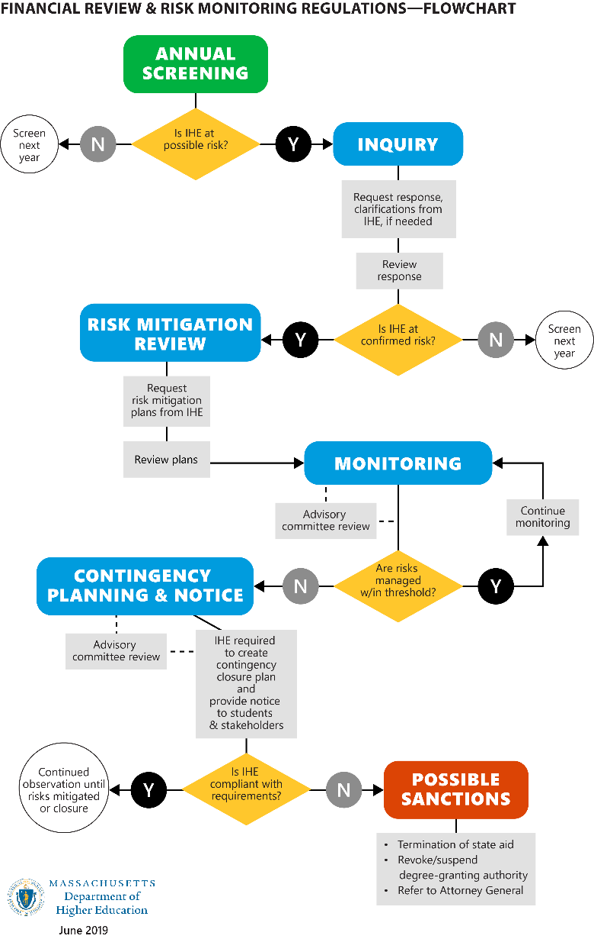
610 CMR 13: Content
BHE Authorization to Solicit Public Comment: 610 CMR 13
Annual Review Process
Screening & Inquiry
Risk Mitigation Review & Monitoring
Contingency Closure Planning & Notice
Advisory Committee
Confidentiality
Sanctions

Slide 5
610 CMR 13: Content
BHE Authorization to Solicit Public Comment: 610 CMR 13
I. Annual Review Process
of all IHEs
BHE Mandate: DHE annual function
Multiple measures and sources*
Defined Standard: “at risk of imminent closure”
Approaching the 18-month rule*
opened for those ID’d as “at risk”
Opportunity to review results and respond
False positives: Screened out
Risk confirmed: IHE moves to next phase
* To be refined through policy

Slide 6
610 CMR 13: Content
BHE Authorization to Solicit Public Comment: 610 CMR 13
IHEs screened as “at risk” must submit Risk Mitigation Plans to Commissioner
Content: Must substantiate capacity to substantially fulfill obligations to students for next 18 months
Notice to IHE governing board by DHE
Commissioner reviews and determines* whether Plans demonstrate likelihood of mitigating “risk of imminent closure”
If yes,
If no, plus *
* Use of Advisory Committee Review and Recommendations at these critical stages

Slide 7
610 CMR 13: Content
BHE Authorization to Solicit Public Comment: 610 CMR 13
Advisory Committee
May be used by Commissioner at any stage of process and may be requested by IHE
Policy will delineate specifics
Year 1+ contemplates mandatory use at critical stages
Confidentiality
To maximum extent permissible under state law
Possible Sanctions
Termination of state aid (OSFA agreement)
Revocation/ suspension
AG referral

Slide 8
610 CMR 13: Timeline & Next Steps
BHE Authorization to Solicit Public Comment: 610 CMR 13
June 28: Regulations submitted to Secretary of Commonwealth for publication in Massachusetts Register
July 12–August 9: DHE solicits public comment on proposed regulations (4-week public comment period/ 3 hearings)
Week of August 12: Finalize regulations, with any necessary changes resulting from public comment; distribute to BHE
August 19: BHE Special Meeting for BHE approval of:
Final Regulations
Associated implementation policies
Fall 2019: Implementation / periodic updates to BHE

Slide 9
Discussion

Slide 10
BHE Motion 19-06
BHE Authorization to Solicit Public Comment: 610 CMR 13
The Board of Higher Education hereby:
authorizes the Commissioner to proceed in accordance with the Administrative Procedure Act, M.G.L. c. 30A, § 3, and
solicit public comment on the proposed regulation 610 CMR 13.00: Financial Review and Risk Monitoring of Institutions of Higher Education.

